Slide 1
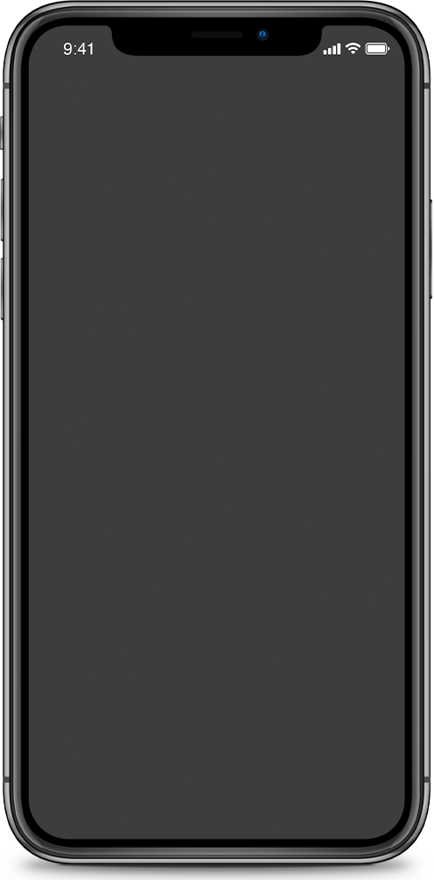
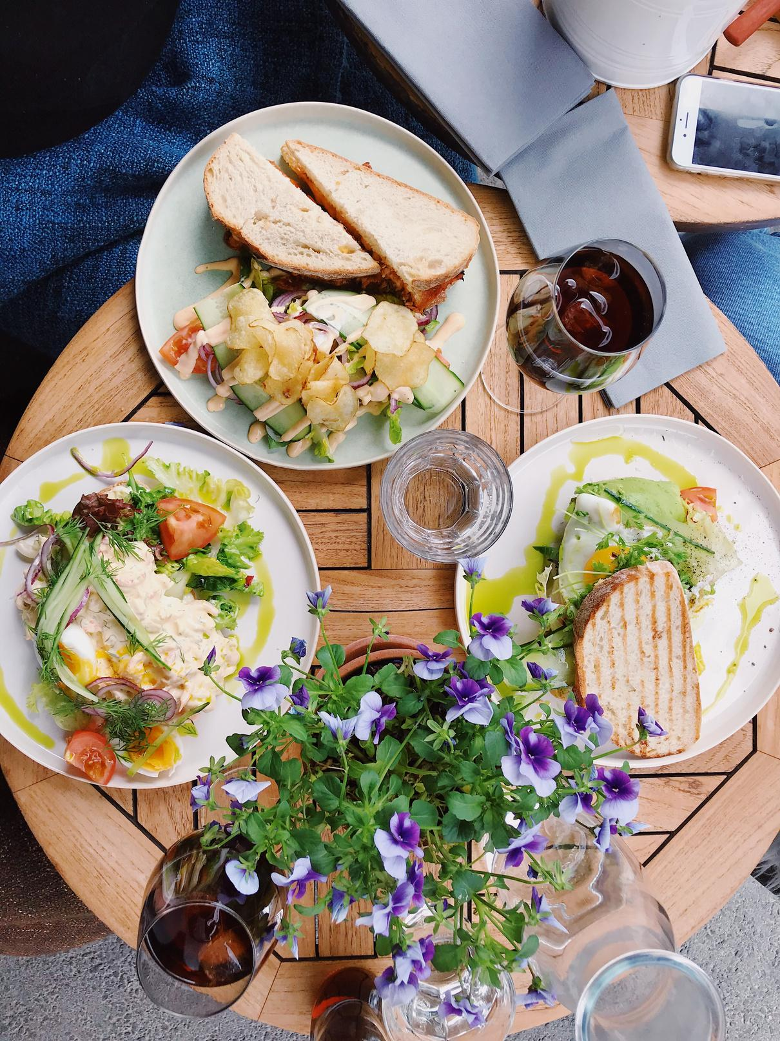

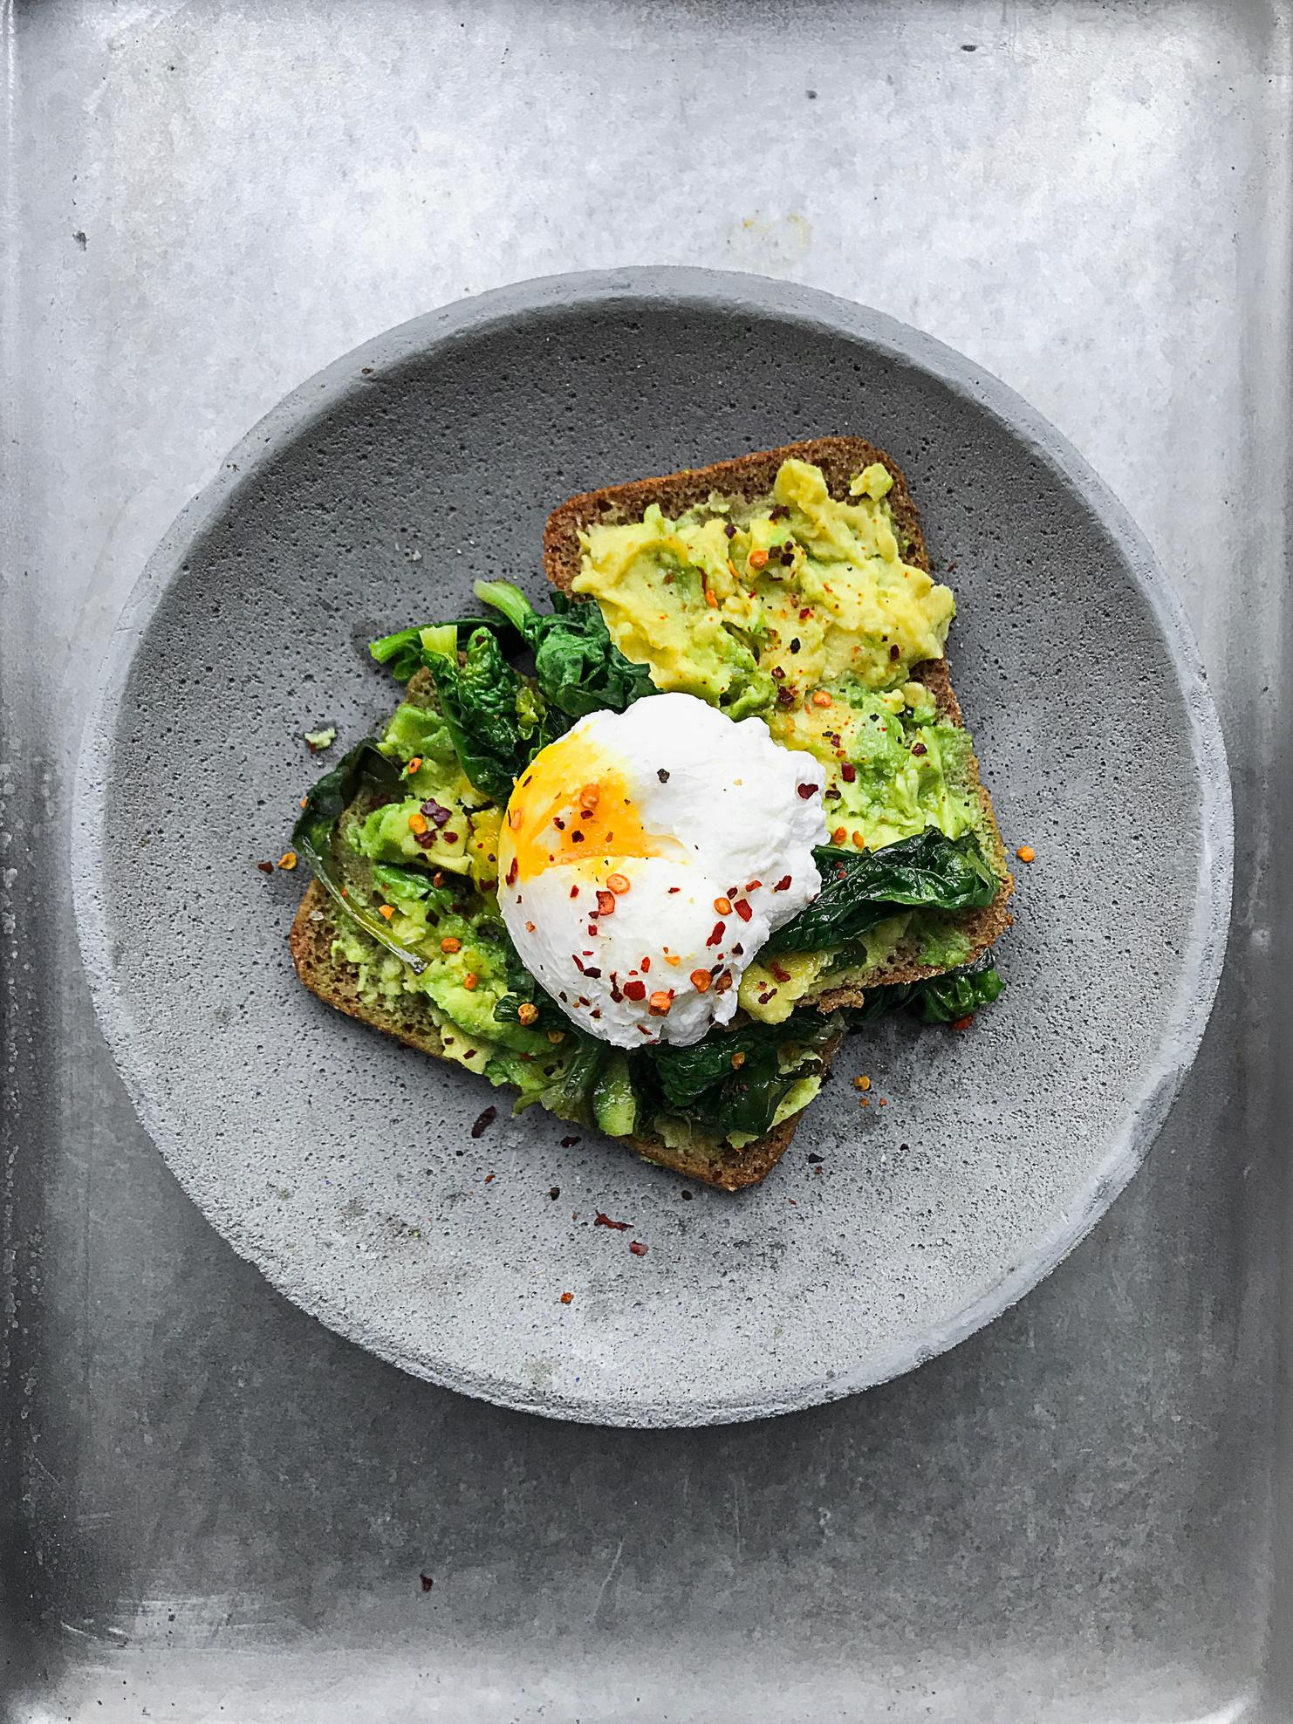

A PERSONAL CHEF - DELIVERED
Hand crafted food made-to-order by professional cooks in your neighbourhood

Slide 2

Project Description
HomeBite is a food delivery platform that connects local home chefs with customers looking for delicious, healthy, and freshly prepared homemade meals. Our app empowers passionate home cooks to showcase their talent and earn from the comfort of their kitchens while customers enjoy the warmth and authenticity of home-cooked food.

Slide 3
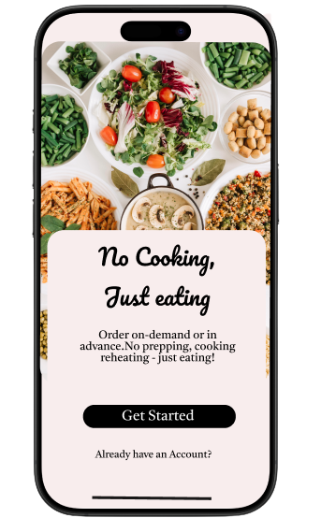
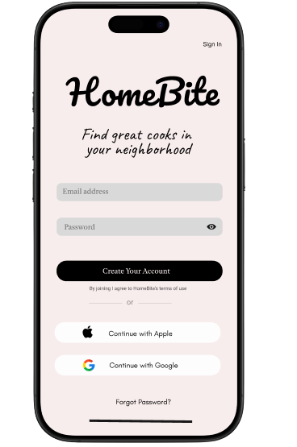
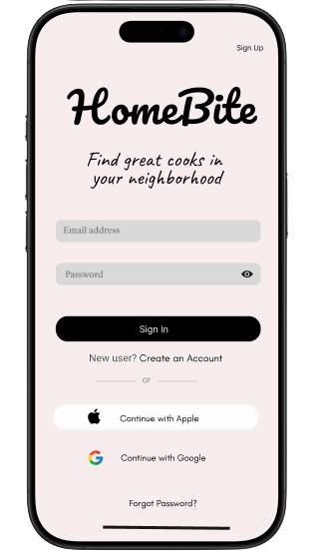
Login and Signup Pages

Slide 4
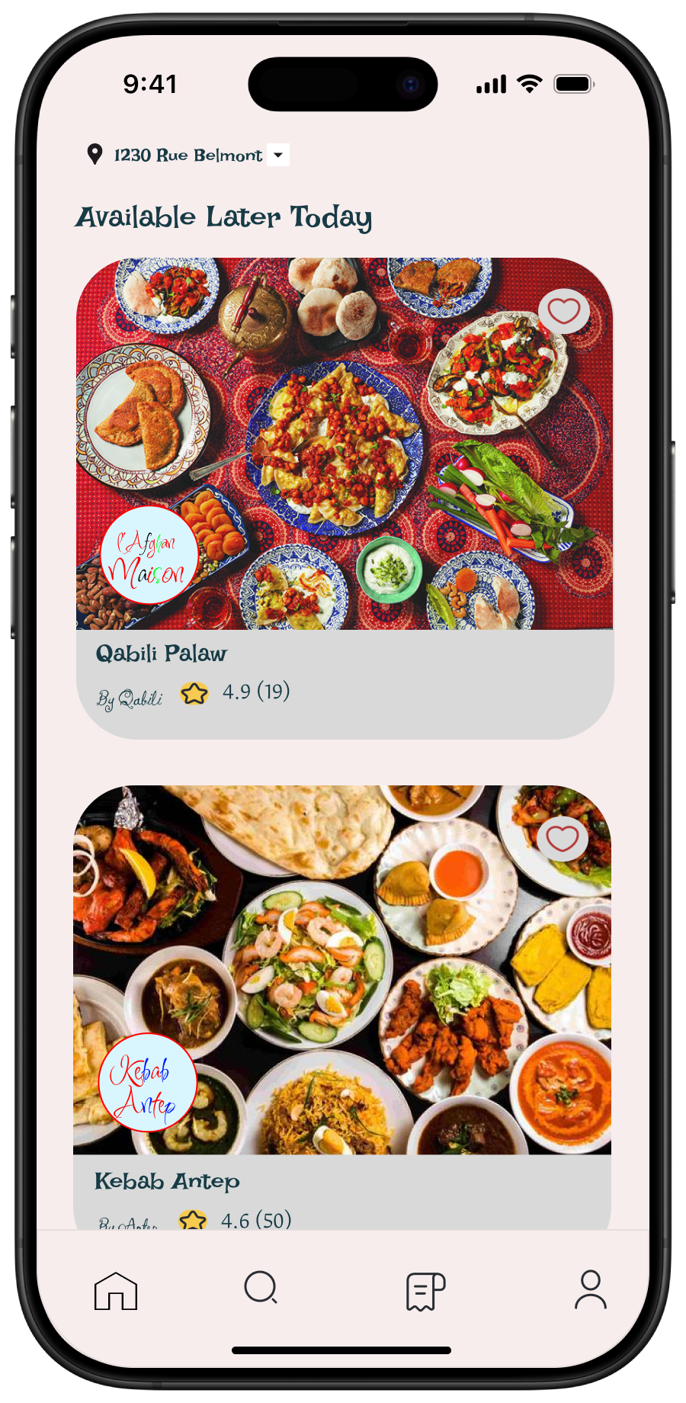
Home Screen

Slide 5
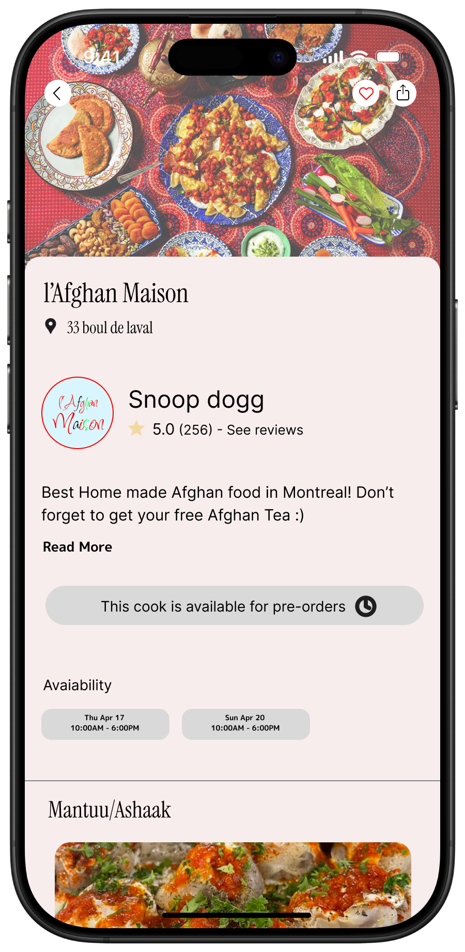
Menu Screen

Slide 6
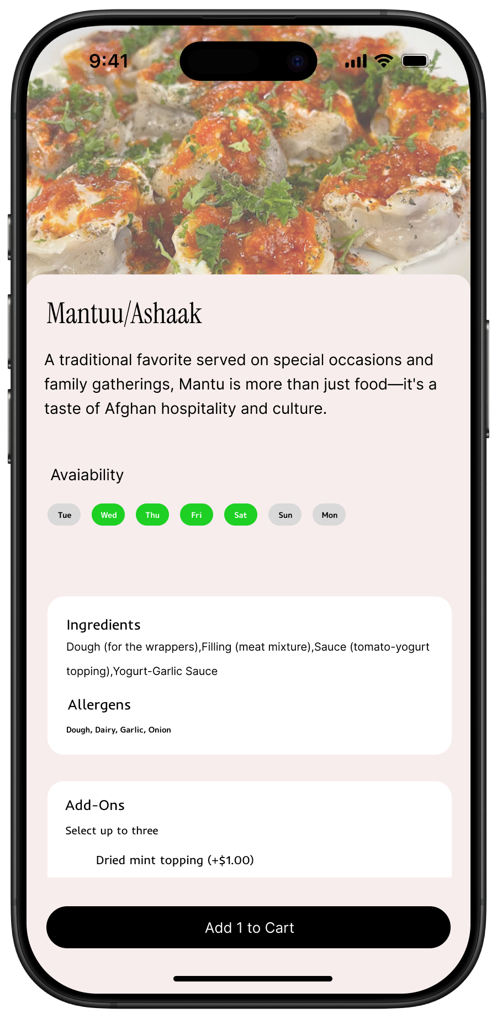
Item Details Screen

Slide 7
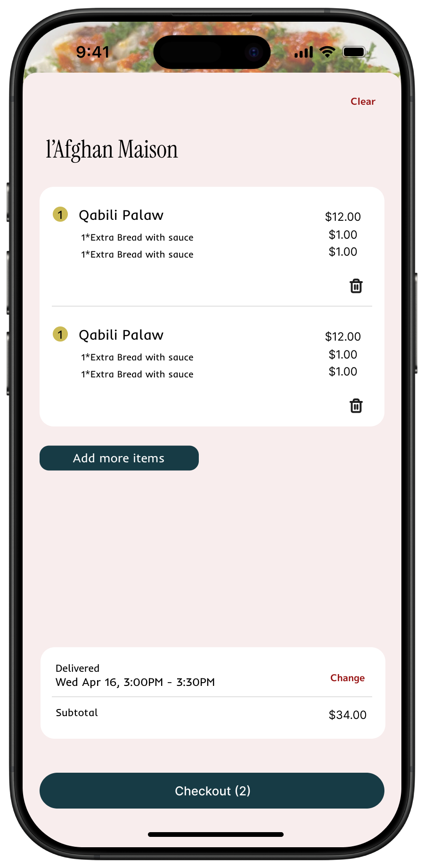
Cart Screen

Slide 8
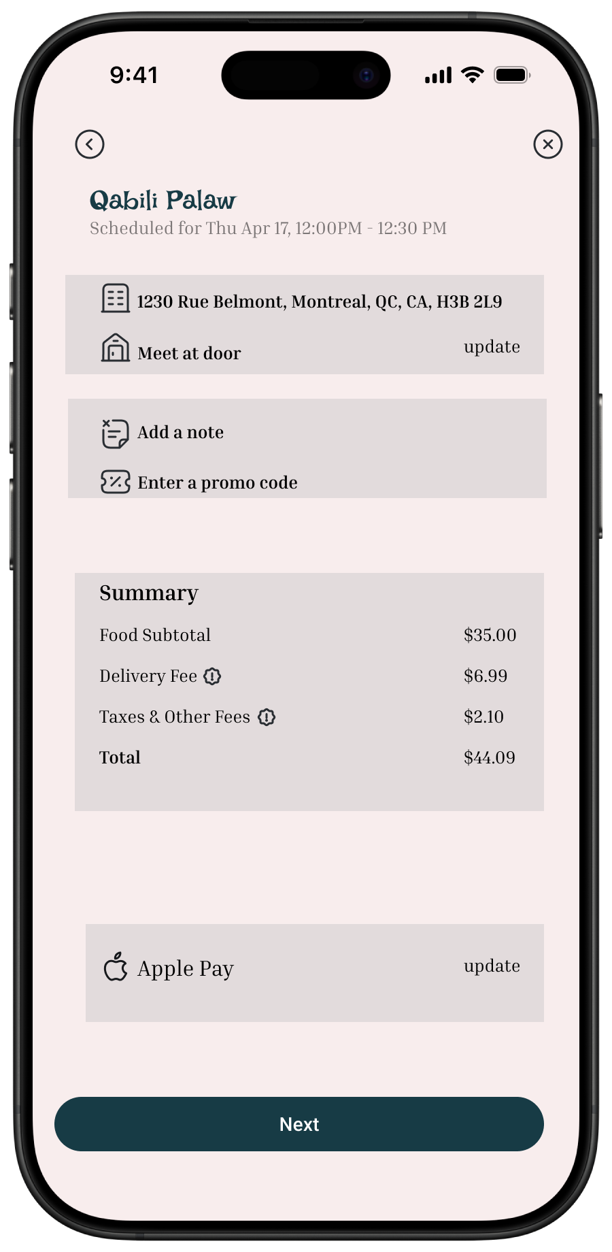
Checkout Screen

Slide 9
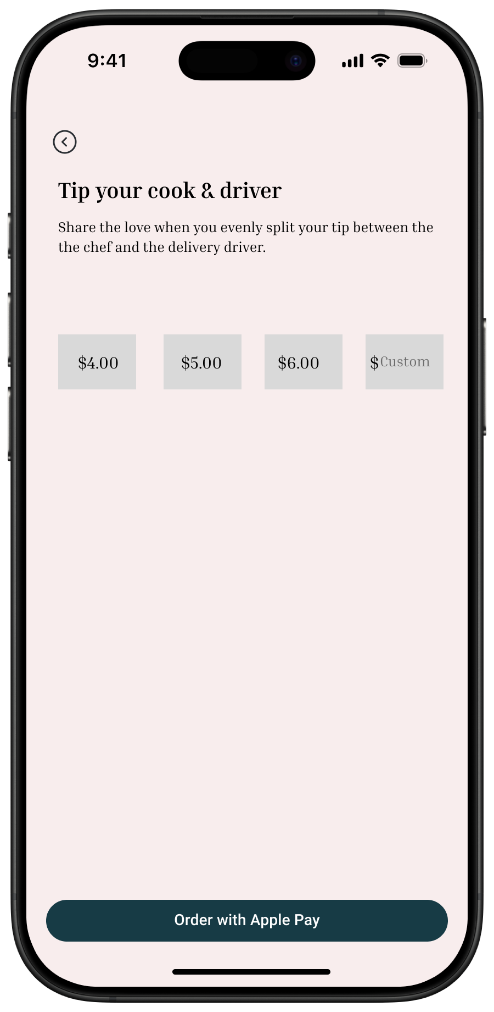
Payment Screen

